Slide 1
Oreilly – Java Concurrency

Slide 2
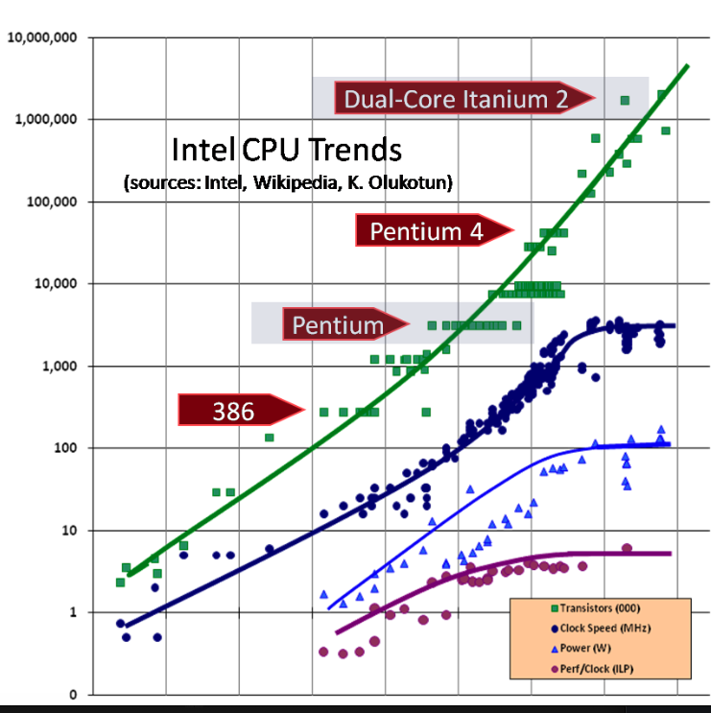
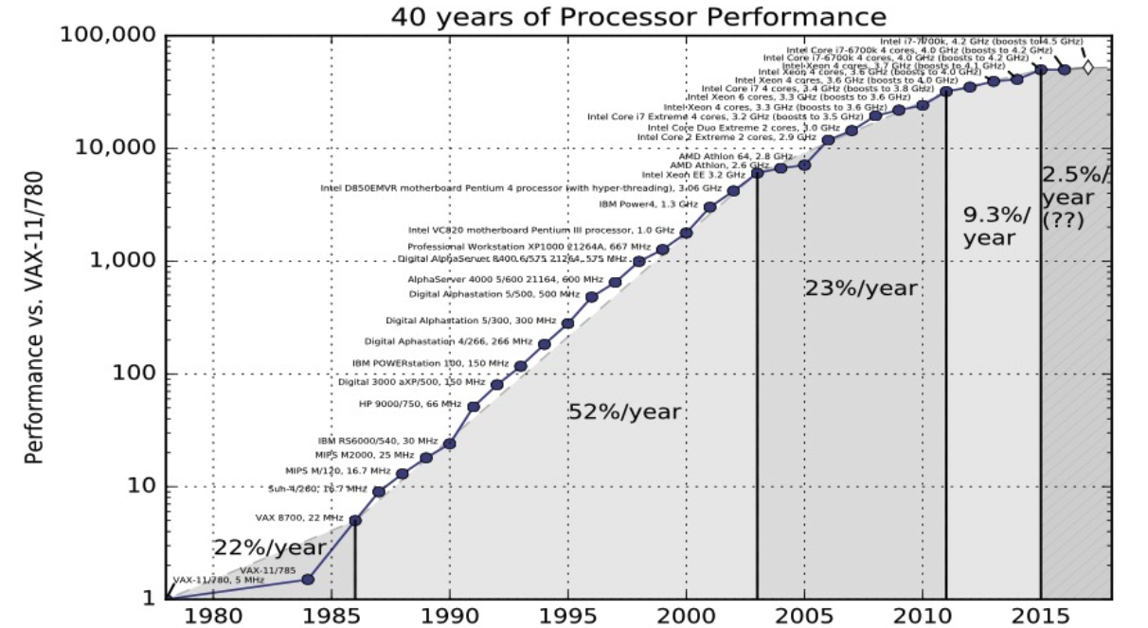
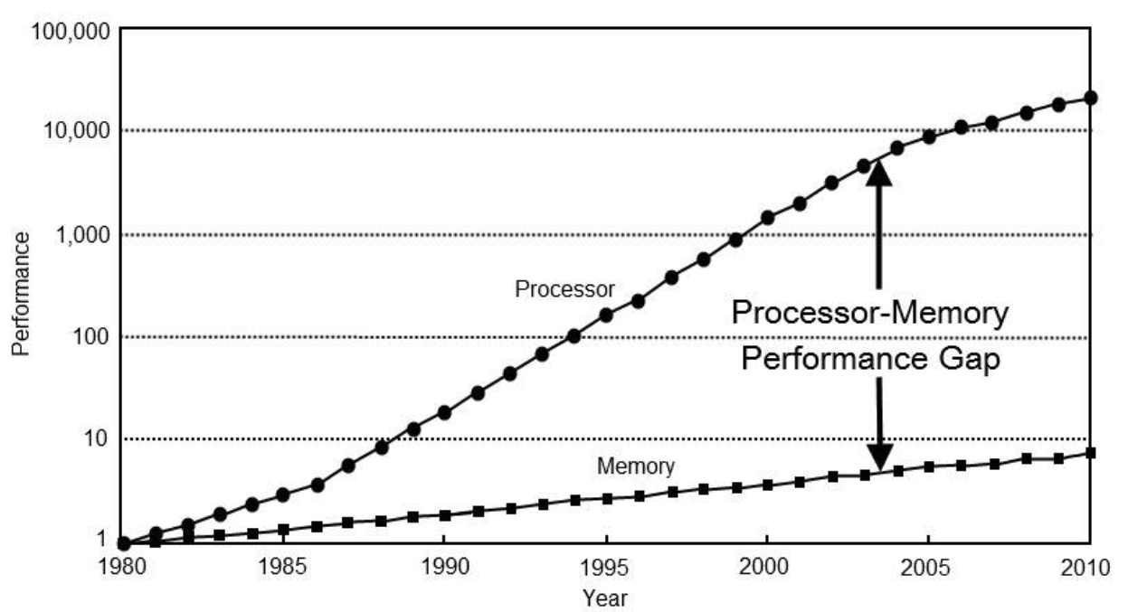
Hardware
Concurrency
  Performance – Efficient use of resources
  GUI – Illusion of always performance
Log Linear – Exponential Growth
A Scary Graph – To the Right
  We added more Transistors but
    clock speeds have plateaued
    Need more wats so generating more heat so need better cooling system
      Heat gets to hight could melt the silicon chips
    Boot out at 18 instructions
What happens to overall performance as the increase CPU Performance decreases
  software optimization become more important
Speed Memory
  1980 – Took the same time to do a multiplication as access memory
  Takes a 1000 time long to achieve data than to operate one it

Slide 3
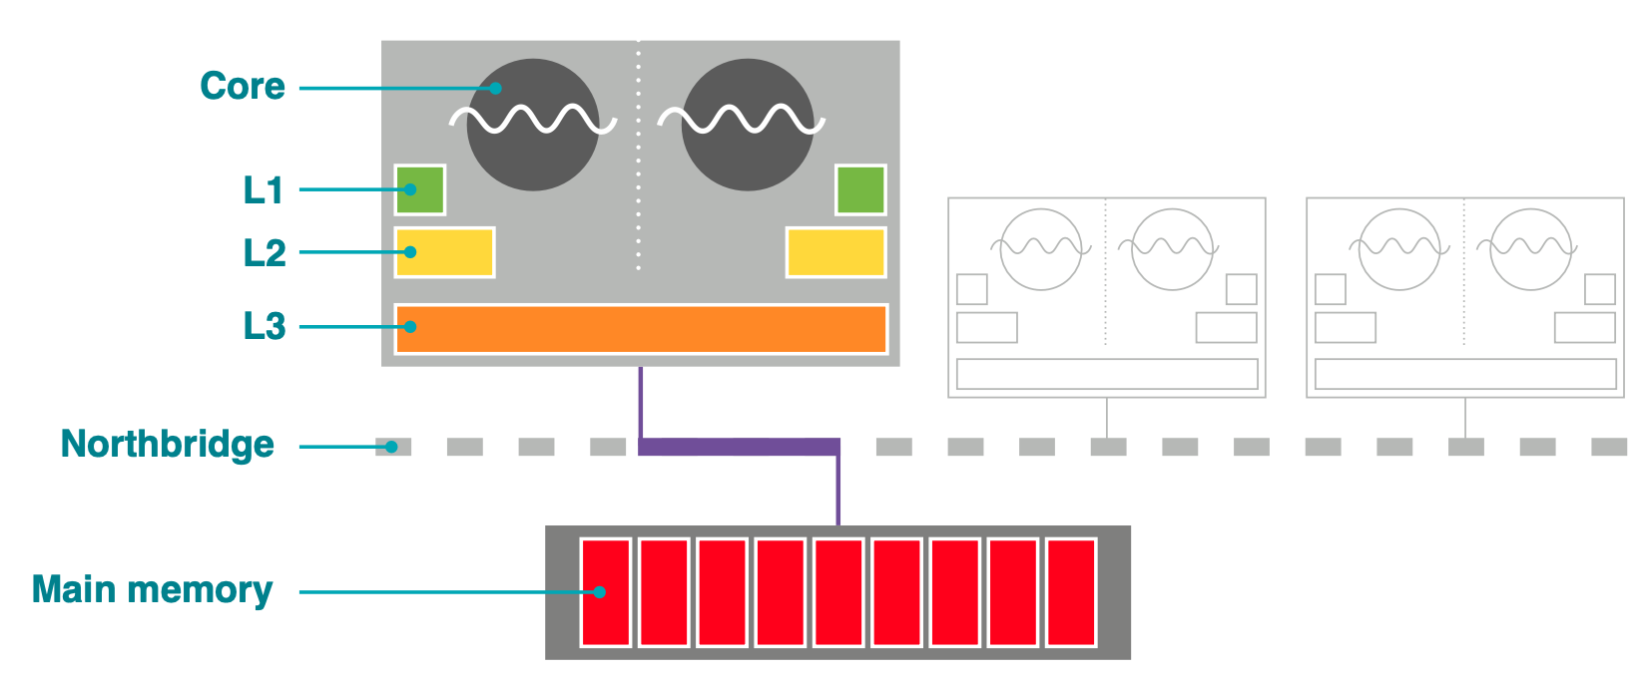
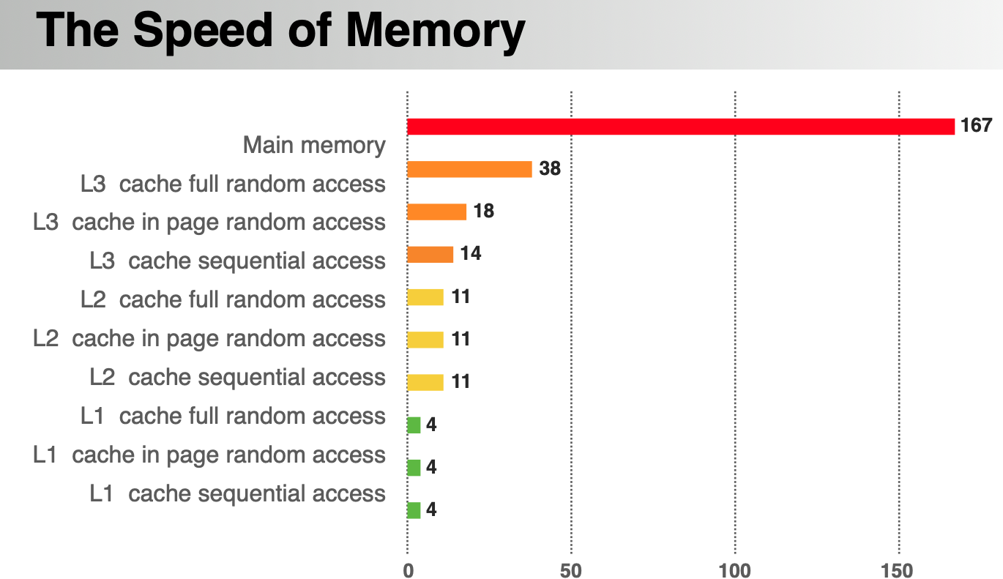
Hardware
  We get stalled waiting for data -- The processor is idle. ( Use Picture from previous page )
    How to improve
      Could make our CPUs multicore
      Could add Caches
  Scary Clown
    We have two cores with L1, L2 and L3 Caches, A Northbridge (bus) and memory
    Adding cache is where we get the performance back using multicore
    L1, L2, L3 Cache are all the same ( 6 transistors in a pattern – get one bit of cache )
      L1, L2 are private and L3 is shared between cores.
      Ex. 1 Meg of Cache is 48 million transistor
        Need the transistors for other such as processing cores
      Why is there so little cache
        Number of Transistors
        Arrangement – How far the cache is away from the
        cores determine the speed of the cache
        Geometry – Go further away bigger ( more space ) ,
        close to the CPU core less space
    Speed of the North Bridge
    So now the processor can gets it data from L1, L2, L3 or from memory using the North Bridge
    Rule of Thumb
      Registers – No Waiting
      4 clock Cycles L1 and 167 clock cycles L2, 300 to 400 for main memory

Slide 4
Demo -- Caching
Prerequisites
  TouchEveryLine, TouchEveryItem first to make sure there is no JIT Compilation or other weirdness
  Using primitives to avoid garbage collection effects and object allocation
When doing performance measurements remember Java is a noisy language
  number within 10% should be the same
  performance – Run on machines that have only as much needed to perform the tests
Results
  When touchEveryLine is doing every eighth vs all. Why does it take the same amount of time?
    Vast Majority of the work is moving data backwards and forwards through the Northbridge from main memory
    Done in chunks of one whole cache line
      The real work is dominated by the transfer time of to and from main memory
  When considering times it is not only your work, but the JVM, the hardware and timings

Slide 5
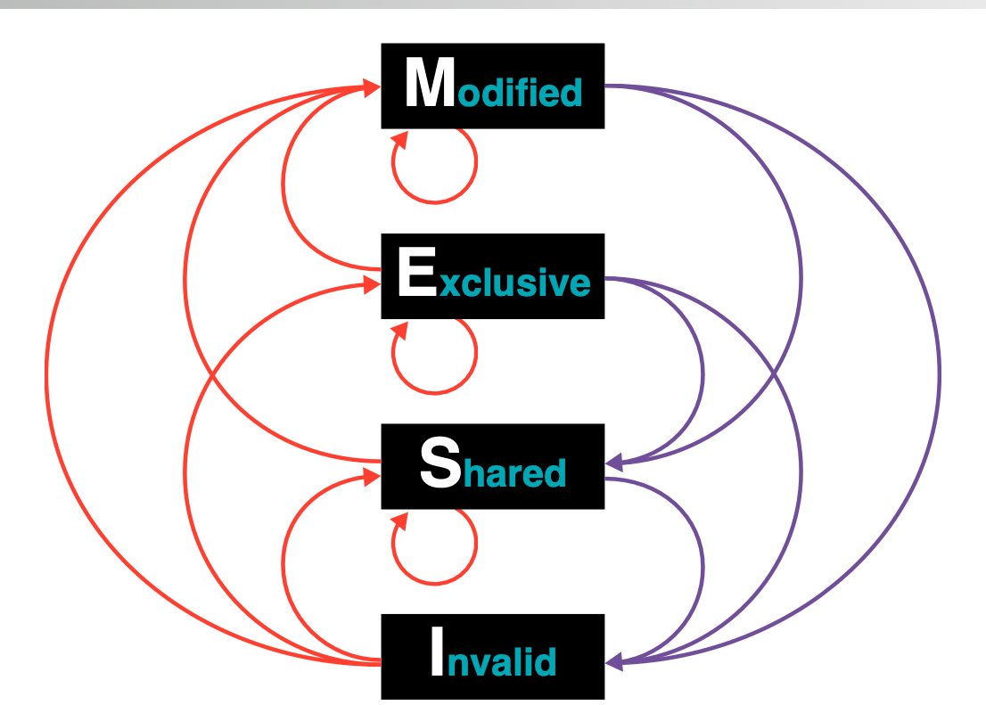
Need for Syncrhonization
2 processes or 2 cores or 2 threads are trying to access the same data –
core of why we need synchronization
Strong or weak memory model
  Java has a weak memory model
  Defined by the MESI protocol ( Modified, Exclusive, shared, invalid)
    At the hardware level
    approach to how hardware wants to share memory in a consistent or
    inconsistent way
    The Java Model of synchronization will be built on top of MESI

Slide 6
Fundamental Concepts of Java Concurrency
Fundamentals
  shared – visible by default mutable state
    All Java threads live in the same process
    The Same process shares the same heap ( The heap is always visible by all the threads )
      and no software protections from being modified
    How do you coordinate them
  preemptive thread scheduling ( Each thread gets a certain amount of time to run )
    Java Threads are Operating Threads
    They are managed and scheduled by the OS
    The OS does not communicate with the User Thread in any way.
      Threads get started and stop by the OS
      The thread may not be finished updating when it is stopped
    What happens when a thread is swapped off a core?
      Thread is suspended immediately
      It may be in an inconsistent state
  Objects must be locked to product vulnerable state
    A mechanism to say this object is not available and some other process is busy with it
    Even reading the thread could provide incorrect information

Slide 7
Java Concurrency Model
To protect against inconsistency, need to use exclusion
  only available mechanism
  synchronized key word which must be opt into
All code using share mutable state inconsistent must cooperate
  Modifies or reads
  Code which does this is concurrently safe
  Ex. Five different classes which are using shared mutual state and every method that touches the shared mutual state must have synchronized box or methods

Slide 8
Objects must be locked to Protect Vulnerable State
Basis of intrinsic concurrency approach
A Java Thread is an OS thread
  Thread.start() calls the OS to clone() a new thread which is the owner of thread
java.lang.Thread is just a metadata object
OS Monitors used to awake threads
  When a synchronized block/method is hit then if the object is not available we sleep and when the object is found the OS alerts the java program
The OS does a lot:
  Creating Threads
  Putting Threads to sleep
  Waking Threads up

Slide 9
Java Concurrency Model
What does synchronized do
  At a hardware level synchronizing main memory and caches.
    Main Memory Representation of object being locked.
    Happy Path
      Blue locks the thread
      Copies the data from main memory into cache
      Does the operations and writes to main memory then release the lock.
    Unhappy Path
      Get Swapped Out
      Write Back to main memory and hold the lock
    Read from memory at start and write to memory at end of block.
    Either acquire a lock or fail to acquire a lock ( in which case you block until it becomes free )
  Exclusive ownership of an object
    When a synchronized lock is acquired the current thread owns the object
    modify an object’s shareable state – Indication of temporary exclusive access to the object.
      acquire object’s monitor ( stored in object header )
  Critical Section – Only one thread at a time is allowed into this critical section of code.
    An object can inconsistent for period of time when synchronized

Slide 10
Volatile
provides exclusive access to data by synchronizing the cache of one thread with the main memory representation
  It provides critical section behavior
  Provides 1 operation to or from main memory
    No locking is involved
    Caches are flushed.
  When a field is declared volatile – Before using this variable with reading or writing ignore what is in the caches
    Read a volatile variable then discard current value in the cache and read directly from main memory
    Write a volatile variable put the value in the cache and flush it up
  Volatile variables cannot be used for state dependent updates
    Can’t do v++ with volatile, but use a synchronized block ( 2 operations since v appear on the right and left hand side )
    not safe for state dependent updates
  Volatile cannot cause deadlocks since they have no locks
Java Concurrency is protect vulnerable mutable data ( it is about the data and not the objects )
Examples from ChatGPT
  Example a flag within a multi-thread operation

Slide 11
Demo -- Synchronization
Why don’t we synchronize every method on Java
  Unsafe = 5 second 50% loss
  Synchronized = 504 second 0% loss
  Volatile = 277 50% loss
  AtomicCounter() = 279 0% loss
  Difference is an order of magnitude 2
synchronized(this)

Slide 12
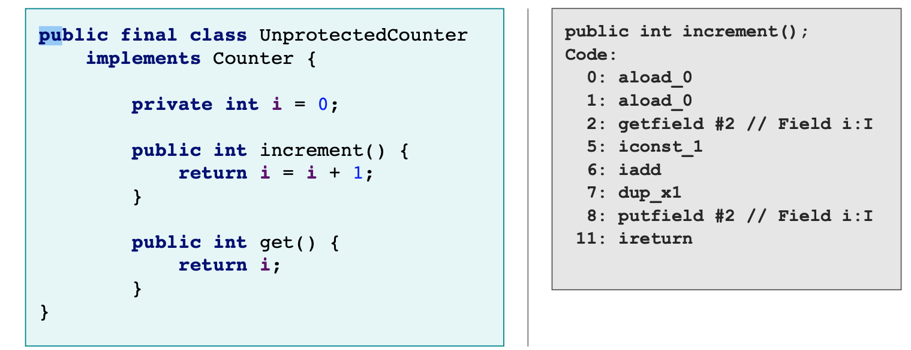
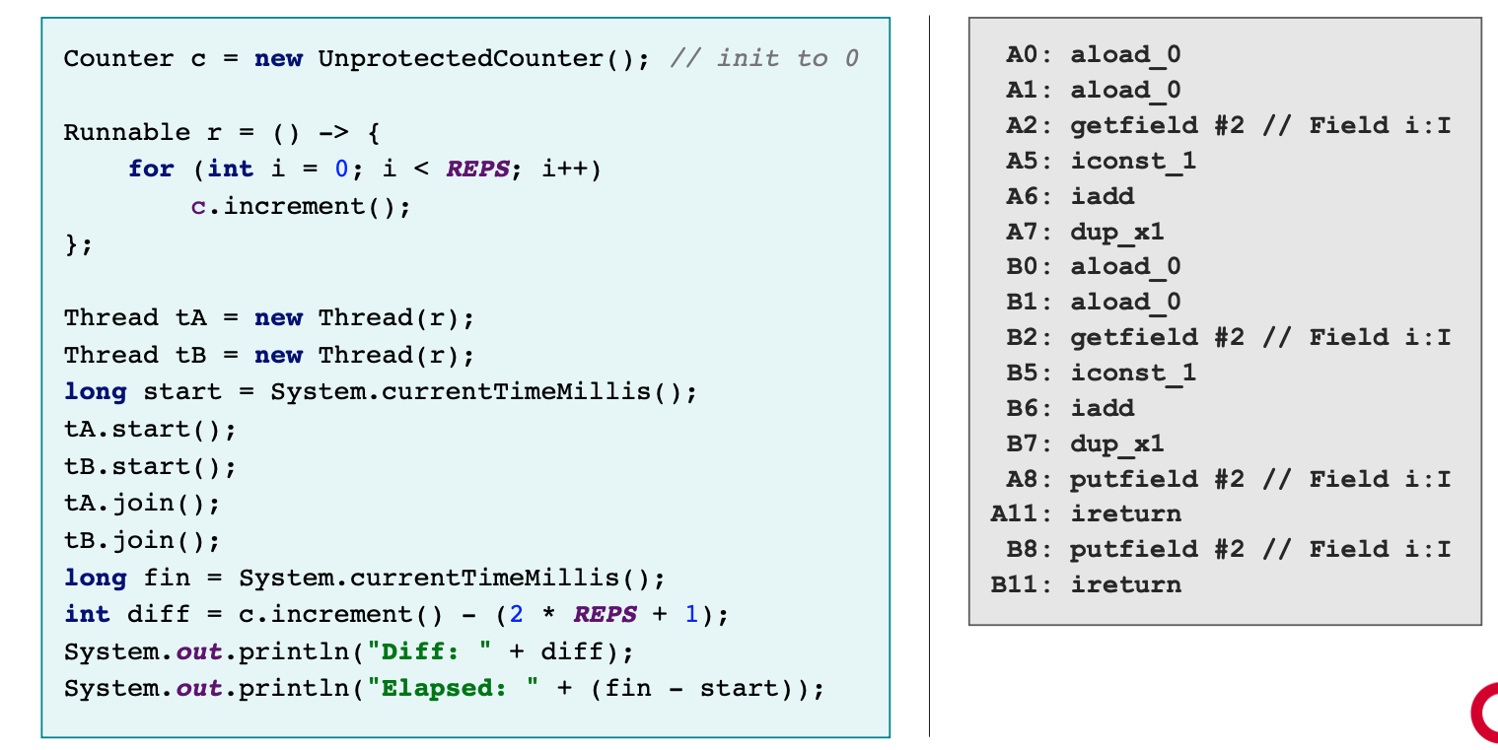
Fun with Counters
Stack Machine
First Picture is a Single Thread Program which works fine
Second Picture is a Multithreaded Program
  A context switch happens at process 8.
    I was changed and it is still sitting in thread A’s private stack and not the heap.
    When Thread B read the memory it gets the original value of I
  Synchronized
    bytecode operations: monitorrenter, monitorexit – Start and End of Thread
    Context
      monitor exit can also be used in exception handling
Synchronized – See doc/synchronzied.bc
  bytecode operations: monitorrenter, monitorexit – Start and End of Thread
  Context
    monitor exit can also be used in exception handling
    Load the Objects from the Heap Storage, but the value is still on the stack

Slide 13
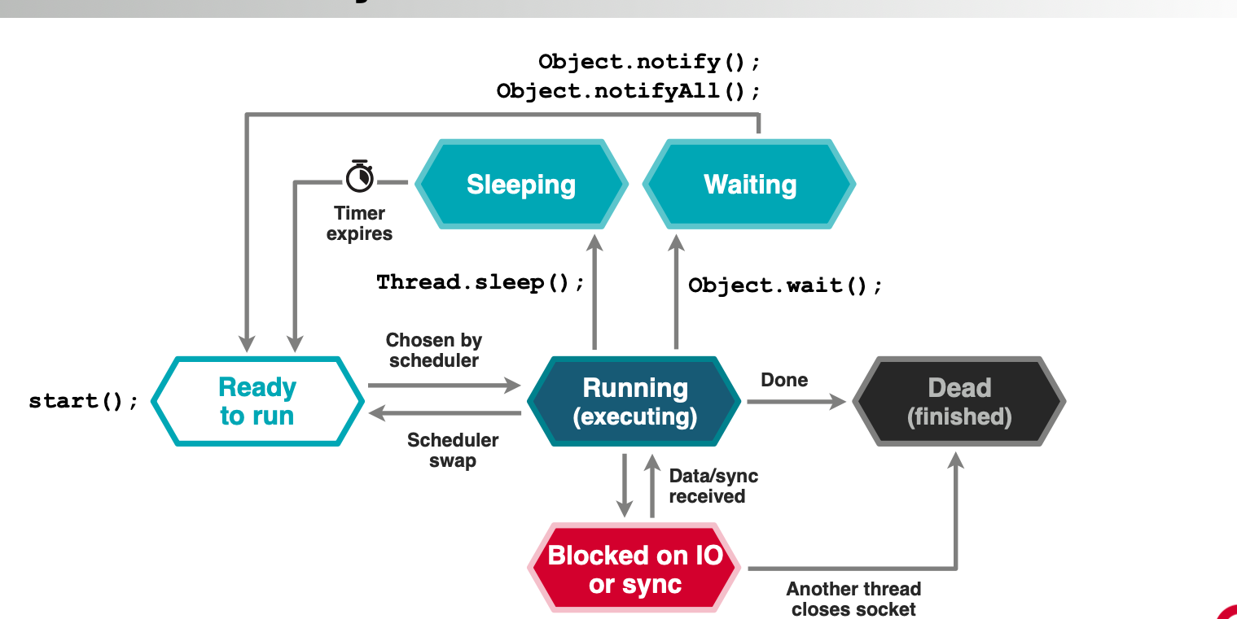
Thread LifeCycle
Timeslice is usually 10 millisecond
States
  Sleep is well defined amount of time or else it goes back to start
  Waiting is an indefinite amount of time
    Done by UNIX Signals

Slide 14
Thread Class
Lightweight unit of execution
  Smaller than a process capable of executing java arbitrary code
Each thread is a full unit of execution to the OS
  Own Stack frames ( belong to each individual thread ) and Program Counter
  Main address heap shared between all thread in the process
  Its scheduled
When a method is entered a new stack is located on it to keep temporaries ( evaluation stack )
Thread States
  New – Thread is created, but have not been scheduled
  Runnable – the thread is running or available to run, but the OS schedules the thread
    Running and Available change so fast it is good to put them into the same state
  Blocked – The thread is not running, but is waiting to acquire a lock or in a system call
  Waiting – The thread is not running but has been called by Object.wait() or join
  Timed_Waiting – The Thread is not running it has called object.wait() or Thread.sleep() -- Dependent on timed waiting
  Terminated – Thread has terminated either successful or threw an exception

Slide 15
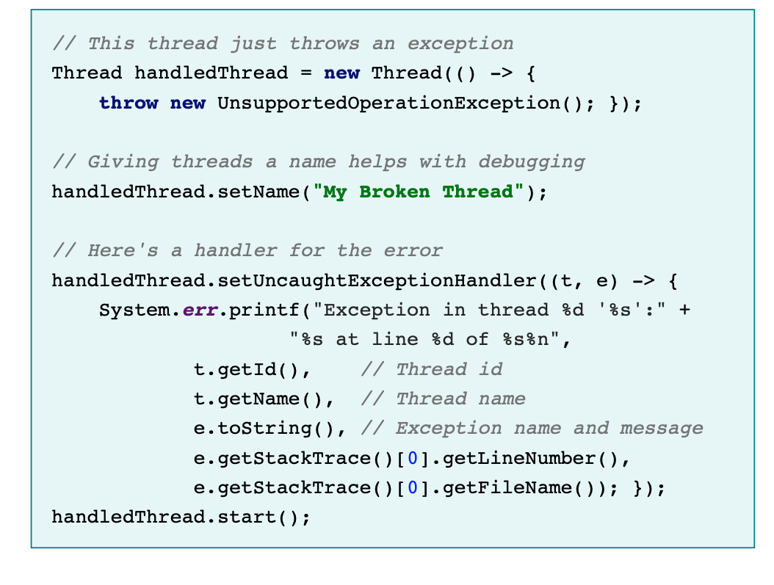
Thread Class
Methods
  getId(), setName(), getName(), setState(), isAlive(), start(), interrupt(), isInterrupt(), join()
    joint – Current thread pauses and wait for other thread to exit
    When the isInterrupt has been called or it is in the exception the interrupt flag has been cleared.
  getPriority(), setPriority(), setDaemon(), setUncaughtExceptionHandler()
2 Types of thread
  daemon thread
  system thread
UncaughtExceptionHandler() -- Run on the handled thread, not the current thread
Never use
  Stop -- Almost impossible to use without violating safety
  Suspend, resume, countStackFrames
    Does not release any monitors – deadlocks
  Destroy – Never Implemented would have suffered the same problems as suspend. ( stop at 130 minutes)

Slide 16
Java Memory Model
What happens when two cores access the same memory model
var handles expands beyond normal access and volatile access
  Fill in later
Questions that the memory model answers
  What happens when two cores access same data?
  When are they guaranteed to see the same value?
  How do memory caches affect this?
  Cache coherency protocols (MESI)
Two possible approaches
  Must code to the JMM not the hardware.
    Intel is much stricter than ARM that it might uncover bug when moved to an ARM processor
  Strong Memory Model ( all cores see the same values )
    requires more implementation code on top of weak hardware
    Scales worse as the number of cores increases
    Cache Invalidation swamps the memory bus
      The throughput from Northbridge going to 0 since so much time would be keeping the memory model consistent
  Weak Memory Model ( special cache instructions ) -- Used by Java
    Fits in better trend in processes
    Make porting easier

Slide 17
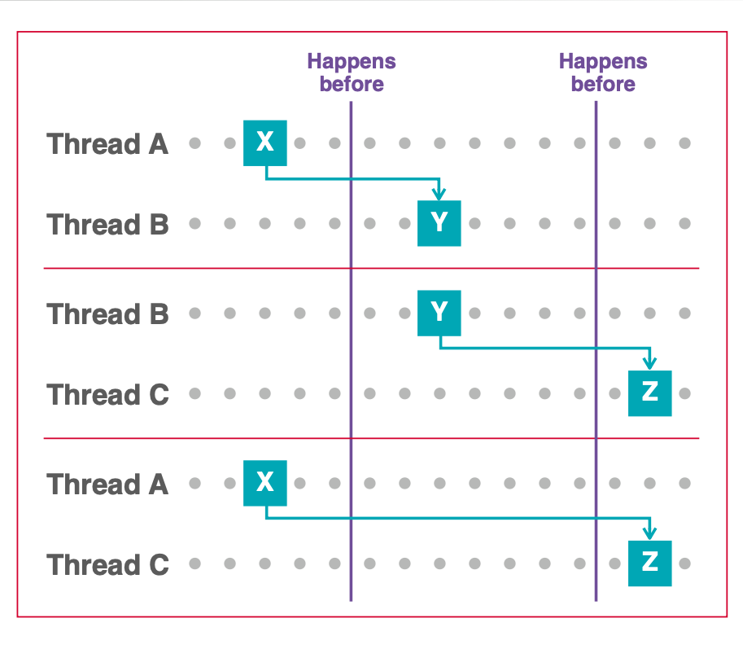
Java Memory Model
Mathematical Description of how Memory works
Most impenetrable part of JLS
JMM makes minimal guarantees – Real JVMS and CPUs may do more
Key Concepts ( low level basic set of rules )
  Happens Before
    One block completes before other can start
    synchronizes blocks
  Synchronizes with
    Action will synchronize its view of an object with main memory
    synchronizes with another block at that point
    Volatile is just a synchronize with
    Threads have their own description of an object’s state – must be flushed to main memory and other threads
    synchronized meas the local view has been synchronized with other threads
    Define touch points where threads must peform syncing
  As-if Serial
    Instructions appear to execute in order
    Looking as an outside thread means that the instructions will execute in order – Inside the thread the instructions can be order in any way.
  Release-Before-Require
    lock release before another thread requires it
Synchronize Blocks are a combination of happens before and synchronizes with primitives
volatile is a synchronizes with

Slide 18
Summary
Unsynchronized methods – Don’t care about the state of locks and can run while other methods are running
only objects can be locked not primitives
  primitives are collection of bytes, don’t have an object header such as an class
  can be immutable, but has a header that cannot be changed
  arrays are objects
  For an array must lock the object and the internal values of the outside
Locking an Object[] does not lock the individual objects
A synchronized method is equivalent to a synchronized (this) { ... } block that covers the entire method
Synchronization of an inner class is independent of the outer class
When locking class objects two options
  explicit lock on class liter using getClass()
  Both approaches have different behavior in subclasses
Synchronized is not part of the method signature it can not appear on a method declaration of the interface
Java locks are reentrant – A recursive call to to synchronized methods will not self dead lock

Slide 19
Deferred Executions
A class is the smallest unit of functionality
  Functionality is loaded and linked as classes
  Must go through class loading
Java has no free functions
Tasks to be executed is represented as an object
  instance of some interface
Representing execution means were deferring execution
  Have a reference to some code which will be executed later
  Callable – Here is some code run it and when call is return then the return value is returned
  Supplier – Use the value when you get when you run this bit of code
  Runnable – Start this code in a different thread via a Thread Constructor
  Callbacks – Here is some code – Call it back when something happens (ex. setExceptionHandler)
Deferring Execution comes up in other contexts
  closures / Lambda Expressions / Function Pointers
  Specialist Task Libraries
  FutureTaks from Java.util.concurrent

Slide 20
Executors in Java.util.conconcurrent
Executors are java’s standard thread pools
Accepts Tasks and execute them on a different thread
  The tasks expects a Runnable Interface
Does not block the thread providing the task
  Pattern : Here is the task and hand it to another thread and the main thread carries on
Tasks may queue if not execution thread is immediately available
  Executors often incorporate a blocking queue
Base interface is Executor Services which is a subinterface of Executor
  ExecutorService Interface is subinterface of Executor

Slide 21
Executors – Stop at 153
java.util.concurrent has factories for making thread pools
  in the Executors Class has a bunch of factories produce customized ThreadPools
  ThreadPools – If you have a thread available it starts are you wait until one becomes free.
    Don;t have to pay the cost of thread creation each time
    Must be able to prove that the task you send it terminates in bounded time or the task from the threadpool will never be returned
      decreases throught put
      Tasks could get loss if shutdown with a queue that is not empty.
      For rate limiting us an rate limiting queue. (153)
  ThreadPoolExecutor is a bas class which is instantiate and general purpose
    Best Practice use what in Executors
    Ready Made ThreadPools – All Based on ThreadPoolExecutor
      newFixedThreadPool(int nThreads)
      newSingleThreadExecutor()
      newCachedThreadPool()
      newScheduledThreadPool()
  If you are not using java.util.concurrent then you end up reimplementing half the classses in it
  product ExecutorService instances
  Example ScheduledExecutorService stpe = Executors.newScheduledThreadPool(2);

